Slide 1

K-Means Clustering on the Iris Dataset – Case Study
DEPARTMENT OF COMPUTER SCIENCE AND ENGINEERING
STANLEY COLLEGE OF ENGINEERING & TECHNOLOGY FOR WOMEN
(AUTONOMOUS)
(Affiliated to Osmania University, Approved by AICTE and Accredited by NAAC)
Hyderabad - 500 001, Telangana, India
November, 2025
Team members:
Anjali(160623733154)
Sreenidhi(160623733144)
Vignitha(160623733150)
Puja(160623733160)
Ujasvi(160623733162)
Afreen(160623733176)
Akshitha(160623733185)
Guided By:
Dr.R.Manivannan Sir
Team number : 04

Slide 2
Table of Contents:
Problem statement
Background and literature / Technological Review
Planning and design of work
Implementation / Execution
Testing / Validation
Results and analysis
Challenges and Solutions
Conclusion and Future Scope

Slide 3
1. Problem Statement
The goal of this case study is to apply the K-Means clustering algorithm on the Iris dataset to automatically group flowers into clusters based only on their numeric measurements . The challenge is to see whether K-Means can correctly discover three natural groups in the dataset without using the actual species labels . The project aims to compare the formed clusters with the real species ( Setosa, Versicolor, Virginica) and analyze the accuracy and behavior of the algorithm.

Slide 4
2. Background and Literature / Technological Review
The Iris dataset is one of the most widely used datasets in machine learning research.
It contains 150 flower samples belonging to three species: Setosa , Versicolor, and Virginica.
Each sample has four numeric measurements that are commonly used in classification and clustering studies.
K-Means is a popular unsupervised learning algorithm used to divide data into k clusters based on similarity.
Many research studies show that K-Means works well on the Iris dataset because it has clear natural grouping, especially for the Setosa species.
Overall, Iris + K-Means is a standard case study used in data mining and machine learning education to demonstrate clustering concepts.

Slide 5
3. Planning and Design of Work
Identified the objective: to cluster the Iris dataset using the K-Means algorithm.
Collected and inspected the built-in Iris dataset in R using structure and summary checks.
Selected only the numeric attributes required for clustering and removed the Species column.
Prepared the workflow for analysis:
– Data Loading
– Data Cleaning & Preprocessing
– Feature Selection–
– Applying K-Means (k = 3)
– Visualization of clusters
– Evaluation using Confusion matrix
5. Planned & Designed clear plots and outputs to support analysis and presentation.

Slide 6
4. Implementation / Execution
Loaded the Iris dataset using the built-in data(iris) function in R.
Verified dataset structure using str(iris) and confirmed 150 rows and 5 columns.
Selected only the numeric columns (Sepal Length, Sepal Width, Petal Length, Petal Width) for clustering.
Preprocessed the data by checking for missing values and duplicates (none found).
Applied the K-Means algorithm with k = 3, using set.seed(123) for reproducibility.
Generated cluster outputs such as cluster sizes, cluster centers, and assigned labels.
Created two scatter plots:– K-Means Cluster Visualization
– Actual Species Visualization
Exported results and plots for use in the presentation.

Slide 7
5. Testing / Validation
• Verified the input data by checking structure using str(iris)
• Confirmed no missing values or invalid records before clustering
• Validated the K-means model by comparing predicted clusters with actual species
• Used a Confusion Matrix to check how well clusters matched species
• Tested stability by running K-means with nstart=20 to avoid random initialization issues
• Checked visual validation using scatter plots of clusters vs actual species

Slide 8
6 - Results and Analysis
• K-Means formed 3 clusters with sizes 50, 62, and 38
• Cluster centers showed distinct separation for Setosa due to small petal measurements
• Visual cluster plot confirmed clear grouping patterns
• Actual species plot showed natural overlap between Versicolor and Virginica
• Confusion Matrix:
– Setosa → 100% correctly grouped
– Versicolor & Virginica → partial mixing
• Overall: K-Means performed well and aligned closely with the natural biological groups

Slide 9
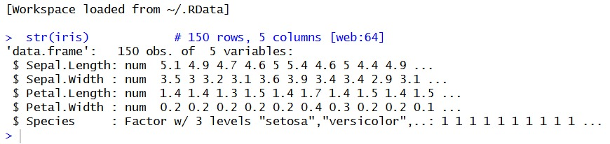
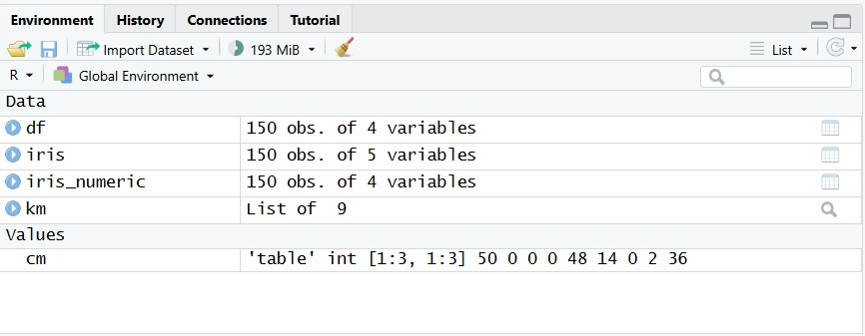
Screenshots & Outputs

Slide 10
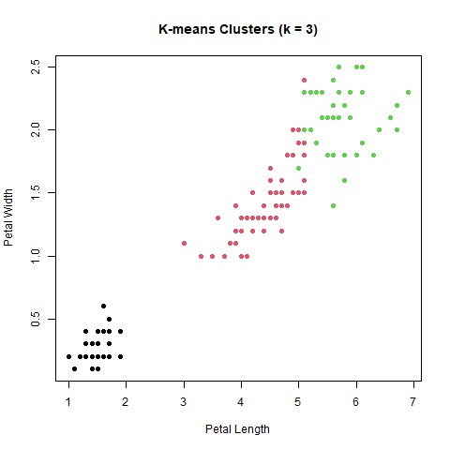
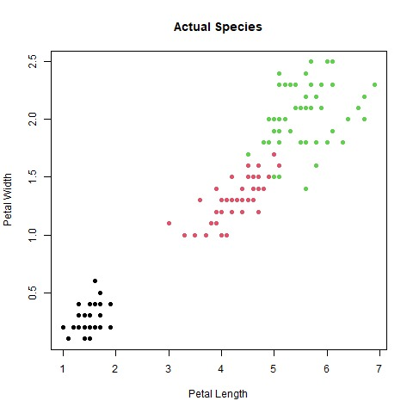

Slide 11
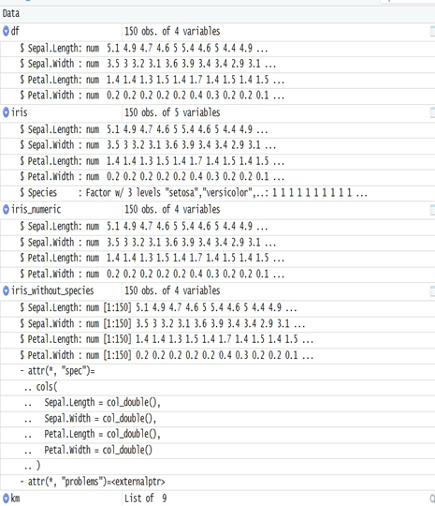
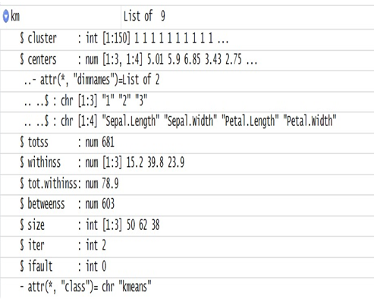

Slide 12
7. Challenges and Solutions
Challenge: Selecting the correct number of clusters
Solution: Chose k = 3 based on domain knowledge of iris species
Challenge: Overlap between Versicolor and Virginica
Solution: Used petal features for visualization to highlight separation
Challenge: Ensuring reproducible results
Solution: Used set.seed(123) during clustering
Challenge: Interpreting centroid values
Solution: Compared cluster centers with species characteristics to understand group meaning

Slide 13
8. Conclusion and Future Scope
• K-Means successfully identified 3 meaningful clusters in the iris dataset
• Setosa was perfectly separated, showing strong clustering performance
• Versicolor and Virginica showed expected overlap due to similar measurements
• The project demonstrates how unsupervised learning can discover natural patterns in data
Future Scope:
• Try other algorithms (Hierarchical Clustering, DBSCAN)
• Perform dimensionality reduction (PCA) to visualize clusters better
• Apply clustering to larger, real-world datasets

